Slide 1
جامعة ديالى
كلية الهندسة
قسم الهندسة الكيمياوية
Unit Operations
Lecturer
Dr Salah N. Farhan

Slide 2
Fluidization

Slide 3
When a fluid is passed upwards through a bed of particles the pressure loss in the fluid due to frictional resistance increases with increasing fluid flow. A point is reached when the upward drag force exerted by the fluid on the particles is equal to the apparent weight of particles in the bed. At this point the particles are lifted by the fluid, the separation of the particles increases, and the bed becomes fluidized.
General Objectives:-
Get benefit from dead zone.
Improvements of Mass & Heat Transfer.
Increasing rate of Reaction, and controlling Temperature due to continuous mixing

Slide 5
For a bed of particles of density ρ_{p}, fluidized by a fluid of density ρ_{f} to form a bed of depth H and voidage ε in a vessel of cross-sectional area A:-

Slide 6
A plot of fluid pressure loss across the bed versus superficial fluid velocity through the bed would have the appearance of Figure 7.1. Referring to Figure 7.1, the straight line region OA is the packed bed region. Here the solid particles do not move relative to one another and their separation is constant.

Slide 7
The pressure loss versus fluid velocity relationship in this region is described by the Carman–Kozeny equation :-

Slide 8
A: Pressure drop = gravitational force. Particles beginto move
B: Bed in loosest position with grains in contact.
B-C: Grains separate and true fluidization begins
C-D: Random travel of particles, particles begin to actsingly, no entrainment of particles → batch fluidization
D: Particles entrained in fluid → continuous fluidization

Slide 9
Uses for fluidization:
1. Chemical reactors
2. Heat exchange
3. Drying
4. Coating
5. Solidification / granulation
6. Growth of particles
7. Adsorption / desorption
8. Others

Slide 10
Advantages of fluidization:
1. Liquid like behavior – easy to control and automate
2. Rapid mixing, uniform temperature and concentrations.
3. Slow to respond to rapid temperature changes.
4. Useful for large and small operations.
5. Heat and mass transfer rates are high, requiring smaller surfaces.
Disadvantages of fluidization:
1. Bubbling beds of fine particles are difficult to predict.
2. Rapid mixing of solids causes non-uniform residence times for continuous flow reactors.
3. Particle break-up.
4. Pipe and wall vessels erode due to particle collision.
Behavior of fluidized beds:
1. Lighter objects float on top of the bed, i.e., objects less dense than the bulk density of the bed.
2. The surface stays horizontal even in tilted fluidized beds.
3. The solids can flow thru and opening in the vessel just likea liquid.
4. The beds have a “static” pressure head due to gravity,given by

Slide 11
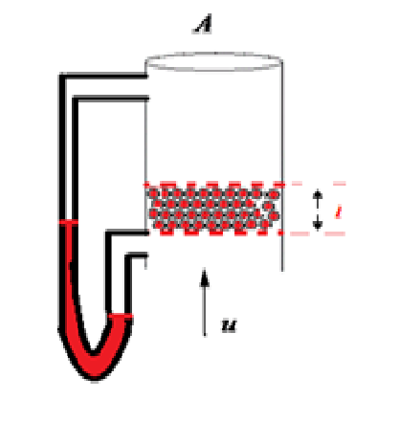
Kinds of Fluidization:-
1)Incipient Fluidization:-
It is occurs at minimum fluidization velocity u_{mf}. In order to determine u_{mf} , starting to increase velocity of fluid gradually with reducing ∆p for each velocity. Then inverse the process by decreasing fluid velocity and recording ∆p then plot log u against log ∆p on log-log paper. Or plot log u against H.
u | ∆p | H
u₁ | ∆p₁ | H₁
u₂ | ∆p₂ | H₂
u₃ . . | ∆p ₃ . . | H ₃ . .

Slide 12
2)Aggregate Fluidization:-
If u>u_{mf} , bubbling fluidization.
If u>>u_{mf} , sludge fluidization.
Fluid and solid densities are greatly different, or particles are large, need higher velocities. Bubbles then brust at the surface spraying particles above the bed.

Slide 13
3) Particulate Fluidization:-
Fluid and solid densities not too different, particles are small. Liquid instead of gas, so bed fluidized evenly with each particle moving individually through relatively uniform mean path.
To distinguished between aggregative and particulate fluidization, use (Fr. No.):-

Slide 14
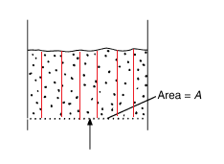
4)Channel and Spout Fluidization:-
At velocity near u_{mf}, particles have fine surface (smooth) and viscous (waxes). Gas passed through channel, this kind is in efficient.
we could use plates in the bed to break on these channels??
5)Transport Fluidization:-
At higher velocity u>>>u_{mf}, for carrying solid materials, cement.

Slide 15
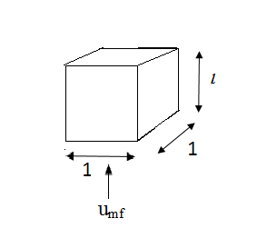
Evaluation of u_{mf} Mathematically:-
Force balance
Pressure force must equal gravity-buoyant force
Sub in Carman-Kozeny Equation:-

Slide 16
At s=6/d for sphere
Bed Height and Porosity
Volume of Fluidized Bed =
Fraction of volume which is solid =
Total volume if the solids were all one piece =

Slide 17
Since the solids volume must be conserved, it follows that
Or
For large value of Reynolds number at incipient fluidization Ergun equation is preferred:

Slide 18
where d is the diameter of the sphere with the same volume/surface area ratio as the particles.
At incipient fluidization, the above equation becomes:
Multiplying both sides by
, we get

Slide 19
Defining Galileo number as
and
Then the equation becomes:
For a typical value of e_{mf} = 0.4, we get:
We can put:

Slide 20
Solving for
, we get:
for e_{mf}= 0.4.
Similar way can be applied for other values of e_{mf}.

Slide 21
Correlation between Sphericity and e_{mf}
The sphericity can be defined as
, where
and
d here is the diameter specified for the particle as it is used in Ergun equation and d_{p} is the diameter of sphere having the same volume. The relation between sphericity and e_{mf} was found experimentally and represented by two relations:

Slide 22
These relations are plotted Fig. 6.3

Slide 23
Minimum fluidizing velocity in terms of terminal failing velocity
The minimum fluidizing velocity, u_{mf}, may be expressed in terms of the free-falling velocity u_{o} of the particles in the fluid. The relation is
The above equation applies when there is no wall effects, that is when d/dt is very small.
Alternatively Fig. 6.4 can be used to find the ratio of minimum fluidizing velocity to the terminal velocity

Slide 25
Liquid Solid Fluidization
In liquid – solid fluidization the expansion of the bed is more regular from the minimum fluidization velocity to the terminal velocity. Liquid – solid fluidization is similar to sedimentation system. The two systems are similar in that in the fluidized bed the particles undergo no net movement and are maintained in suspension by the upward flow of liquid, whereas in the sedimentation the particles move downwards and the is the liquid flow upward which is displaced by the settling particles. The bed expansion can be found by using
Where: u_{c} is the empty tube fluidization velocity,
u_{i} is the corresponding velocity at infinite dilution,
e is the voidage of the system,
C is the volumetric fractional concentration of solids

Slide 26
And n is an index, its values are between 2.4 and 4.8 and can be found by the relation:
The following equation for fluidization was presented to
find the relation between u_{i} and u_{o}:
Alternatively, the index n can be found by using Fig. 6.5

Slide 28
Example:
Spherical solid particles having a size of 0.12 mm and density of 13.6 kg of 1000 kg/m³ are to be fluidized using air at 2 atm and 25 ⁰C. the porosity at minimum fluidizing condition is 0.42.
If cross-sectional area of empty bed is 0.3 m2 and bed contains 300 kg of solid, calculate the minimum height of fluidized bed?
Calculate ∆p at minimum fluidizing condition?
Calculate minimum fluidizing velocity knowing that viscosity of air is 1.845*10⁻⁵ pa.s?
Solution:-
Volume of solid= m_{s}/ρ_{s}
=300/1000= 0.3 m³
L₁= 0.3 m³/0.3 m²=1 m, if ε=0

Slide 29
∆p=
If the velocity is three times u_{mf} find porosity?

Slide 30
Example2:-
3.6 kg of solid particles of density 2590 kg/m³ and mean size 748 mm form a packed bed of height 0.475m in a circular vessel of diameter 0.0757 m. Water of density 1000 kg/m3 and viscosity 0.001 Pa s is passed upwards through the bed. Calculate
(a) the bed pressure drop at incipient fluidization
(b) theminimum fluidization velocity
(c) the mean bed voidage at a superficial liquid velocity of 1.0 cm/s
(d) the bed height at this velocity and (e) the
pressure drop across the bed at this velocity.

Slide 31
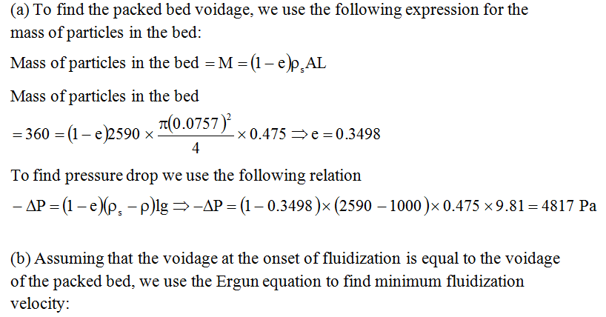
Solution:

Slide 32
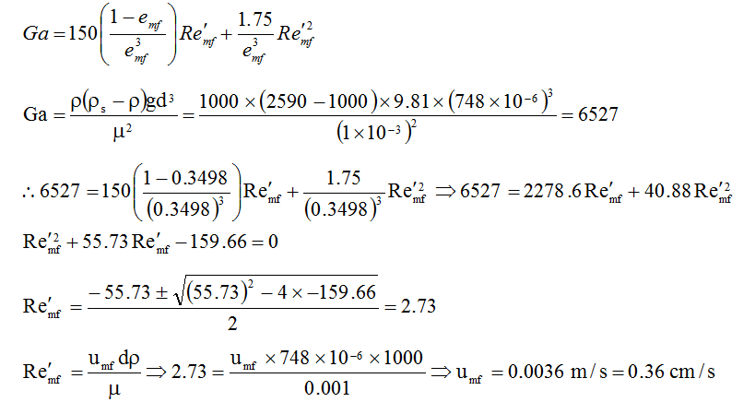

Slide 33
Example
1.15 kg of particles of particle density 2000 kg/m3 are fluidized in a vessel of cross sectional area 0.03m² by a fluid of density 900 kg/m³. (a) What is the frictional pressure drop across the bed? (b) If the bed height is 0.6 m, what is the bed voidage?
2.A packed bed of solid particles of density 2500 kg/m³, occupies a depth of 1 m in a vessel of cross-sectional area 0.04m². The mass of solids in the bed is 50 kg and the mean diameter of the particles is 1 mm. A liquid of density 800 kg/m² and viscosity 0.002 Pa s flows upwards through the bed.
(a) Calculate the voidage (volume fraction occupied by voids) of the bed.
(b) Calculate the pressure drop across the bed when the volume flow rate of liquid is 1.44m³/h.
(c) Calculate the pressure drop across, the bed when it becomes fluidized.
[Answer: (a) 0.5; (b) 6560 Pa; (c) 8338 Pa.]

Slide 34
3.Obtain a relationship for the ratio of the terminal falling velocity of a particle to the minimum fluidizing velocity for a bed of similar particles. It may be assumed that Stokes’Law and the Carman-Kozeny equation are applicable. What is the value of the ratio if the bed voidage at the minimum fluidizing velocity is 0.4?
4.A packed bed consisting of uniform spherical particles of diameter 3 mm and density4200 kg/m3, is fluidised by means of a liquid of viscosity 1 mNs/m2 and density1100 kg/m3. Using Ergun’s equation for the pressure drop through a bed height l andvoidage e as a function of superficial velocity, calculate the minimum fluidising velocity
in terms of the settling velocity of the particles in the bed.
State clearly any assumptions made and indicate how closely the results might beconfirmed by an experiment.

Slide 35
Minimum fluidizing velocity in terms of terminal failing velocity
The minimum fluidizing velocity, u_{mf}, may be expressed in terms of the free-falling velocity u_{o} of the particles in the fluid. The relation is
The above equation applies when there is no wall effects, that is when d/dtis very small. Alternatively Fig. 6.4 can be used to find the ratio of minimum fluidizing velocity to the terminal velocity

Slide 37
Liquid Solid Fluidization
In liquid – solid fluidization the expansion of the bed is more regular from the minimum fluidization velocity to the terminal velocity. Liquid – solid fluidization is similar to sedimentation system. The two systems are similar in that in the fluidized bed the particles undergo no net movement and are maintained in suspension by the upward flow of liquid, whereas in the sedimentation the particles move downwards and the is the liquid flow upward which is displaced by the settling particles. The bed expansion can be found by using

Slide 38
Where: u_{c} is the the empty tube fluidization velocity, u_{i} is the corresponding velocity at infinite dilution, e is the voidage of the system, C is the volumetric fractional concentration of solids, and n is an index, its values are between 2.4 and 4.8 and can be found by the relation:

Slide 39
The following equation for fluidization was presented to find the relation between u_{i} and u_{o}:
Alternatively, the index n can be found by using Fig. 6.5

Slide 40
Example:
3.6 kg of solid particles of density 2590 kg/m³ and mean size 748 mm form a packed bed of height 0.475m in a circular vessel of diameter 0.0757 m. Water of density 1000 kg/m3 and viscosity 0.001 Pa s is passed upwards through the bed. Calculate
(a) the bed pressure drop at incipient fluidization
(b) theminimum fluidization velocity
(c) the mean bed voidage at a superficial liquid velocity of 1.0 cm/s
(d) the bed height at this velocity and (e) the pressure drop across the bed at this velocity.

Slide 41
Solution:
(a) To find the packed bed voidage, we use the following expression for the mass of particles in the bed:
Mass of particles in the bed
Mass of particles in the bed
To find pressure drop we use the following relation

Slide 42
(b) Assuming that the voidage at the onset of fluidization is equal to the voidage of the packed bed, we use the Ergun equation to find minimum fluidization velocity:

Slide 44
1.15 kg of particles of particle density 2000 kg/m3 are fluidized in a vessel of crosssectionalarea 0.03m² by a fluid of density 900 kg/m³. (a) What is the frictionalpressure drop across the bed? (b) If the bed height is 0.6 m, what is the bedvoidage?
2.A packed bed of solid particles of density 2500 kg/m³, occupies a depth of 1 m in a vessel of cross-sectional area 0.04m². The mass of solids in the bed is 50 kg and the mean diameter of the particles is 1 mm. A liquid of density 800 kg/m² and viscosity 0.002 Pa s flows upwards through the bed.
(a) Calculate the voidage (volume fraction occupied by voids) of the bed.
(b) Calculate the pressure drop across the bed when the volume flow rate of liquid is 1.44m³/h.
(c) Calculate the pressure drop across, the bed when it becomes fluidized.
[Answer: (a) 0.5; (b) 6560 Pa; (c) 8338 Pa.]
3.Obtain a relationship for the ratio of the terminal falling velocity of a particle to theminimum fluidising velocity for a bed of similar particles. It may be assumed that Stokes’Law and the Carman-Kozeny equation are applicable. What is the value of the ratio ifthe bed voidage at the minimum fluidising velocity is 0.4?

Slide 46
4.A packed bed consisting of uniform spherical particles of diameter 3 mm and density4200 kg/m3, is fluidised by means of a liquid of viscosity 1 mNs/m2 and density1100 kg/m3. Using Ergun’s equation for the pressure drop through a bed height l andvoidage e as a function of superficial velocity, calculate the minimum fluidising velocity
in terms of the settling velocity of the particles in the bed. State clearly any assumptions made and indicate how closely the results might be confirmed by an experiment.

Slide 50

Calculate the minimum velocity at which spherical particles of density 1600 kg/m³ and of
diameter 1.5 mm will be fluidized by water in a tube of diameter 10 mm on the assumption that the Carman-Kozeny equation is applicable. Discuss the uncertainties in this calculation. Repeat the calculation using the Ergun equation and explain the differences in the
results obtained.

Slide 51
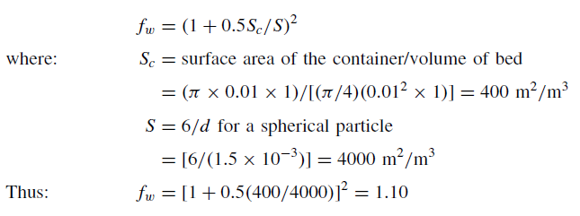

Slide 52
